Slide 1
Mixed-Frequency Forecasting MIDAS vs MF-VAR
Minna Heim, Samuel Bartlett, Michal Dudko
Methods of Macroeconomic Forecasting – HS 2025

Slide 2





Slide 3
Problem & Approach

Slide 4
Motivation: Why mixed-frequency data?
Data is published at different frequencies
Avoid discarding timely high frequency data when forecasting low frequency targets
Exploit ragged-edge information (latest months) without waiting for quarterly releases
Improve short-horizon accuracy while retaining medium-horizon structure

Slide 5
Question: MIDAS vs. MF-VAR
MIDAS
Parsimonious distributed lags for high-frequency inputs
Fast and robust
MF-VAR package
Full joint dynamics with Minnesota + IW priors
Coherent forecasts
MF-VAR implemented manually
Due to lack of maintenance with original package

Slide 6
Data & Methodology

Slide 7
Data
Quarterly (KOF):
GDP Growth
Inflation
CHF-EUR Exchange rate
Monthly:
Total registered unemployment (SNB)
CPI (SNB)
Foreign exchange rate monthly average CHF-EUR (SNB)
SMI return (yahoo finance)
MIDAS uses either MF-VAR latent states or KOF Barometer

Slide 8
Methodology
Separate implementation of our three approaches
Combination and normalisation of code (such that it can run together)
Creating and running combined benchmarks

Slide 9
MIDAS

Slide 10
Methodology: MIDAS

Slide 11
Methodology: MIDAS

Slide 12
Methodology: MIDAS – Final Models
Notes:
Alles bis hier Minna

Slide 13
Methodology: MIDAS Continued
Four distinct MIDAS versions
KOF Baro without trend
KOF Baro with trend
MF-VAR latent states without trend
MF-VAR latent states with trend
Notes:
Alles bis hier Minna

Slide 14
MF-VAR

Slide 15
MF-VAR: Purpose and Core Structure

Slide 16
MF-VAR: State Representation

Slide 17
MF-VAR: Measurement System

Slide 18
MF-VAR: Bayesian Estimation and Minnesota Prior

Slide 19
MF-VAR: Bayesian Estimation and Minnesota Prior

Slide 20
MF-VAR: Hyperparameter Selection through the Marginal Data Density

Slide 21
MF-VAR: Hyperparameter Selection through the Marginal Data Density

Slide 22
MF-VAR: Forecasting

Slide 23
Methodology: MF-VAR Manual Implementation
Notes:
Sam

Slide 24
Methodology: MF-VAR Manual Implementation
Notes:
Sam

Slide 25
Methodology: MF-VAR Package
mfbvar package
Not on CRAN, GitHub: https://github.com/ankargren/mfbvar
Tuning overall tightness: trade-off of RMSE between variables (smaller lambda, worse exchange rate)
Used defaults for other parameters
Notes:
Michal

Slide 26
MIDAS vs MF-VAR
Main Differences:
Cheap vs. Expensive (computationally)
Parameters updated iteratively vs. non-updated
(reduced form) Single Equation vs. Multivariate modelling
Notes:
Minna

Slide 27
Results

Slide 28
Results
Forecast Evaluation
Economic Indicators
Forecasts
Notes:
Michal

Slide 29
Forecast Evaluation

Slide 30
Forecast Evaluation – Cross-Validation
Expanding window
Benchmark Model: AR(2)
Number of Folds: 20
Horizons: 1-step ahead (1 quarter), 1-year ahead (4 quarters)
Train/Validation data Points:
Training expands from 111 to 130 quarters (1992 Q1–2019 Q3 through 1992 Q1–2024 Q2)
Validation = 20 observations per variable/horizon (one per fold)
Error Metrics: RMSE & MSE per variable and extra monthly data
Notes:
Michal

Slide 31
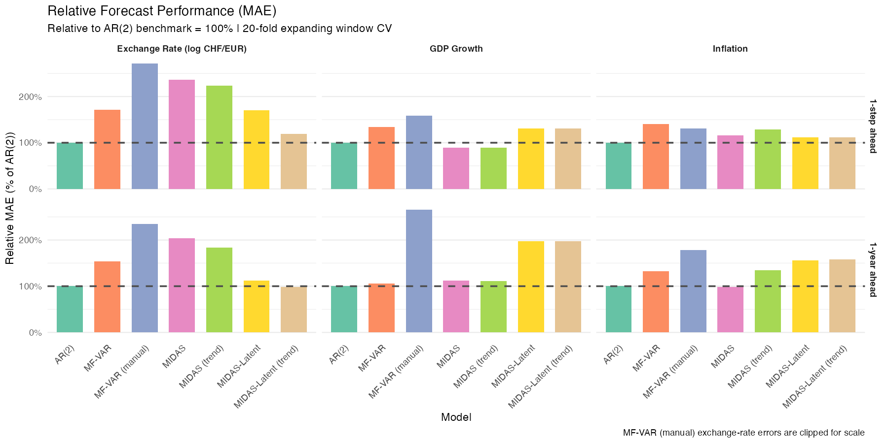

Slide 32
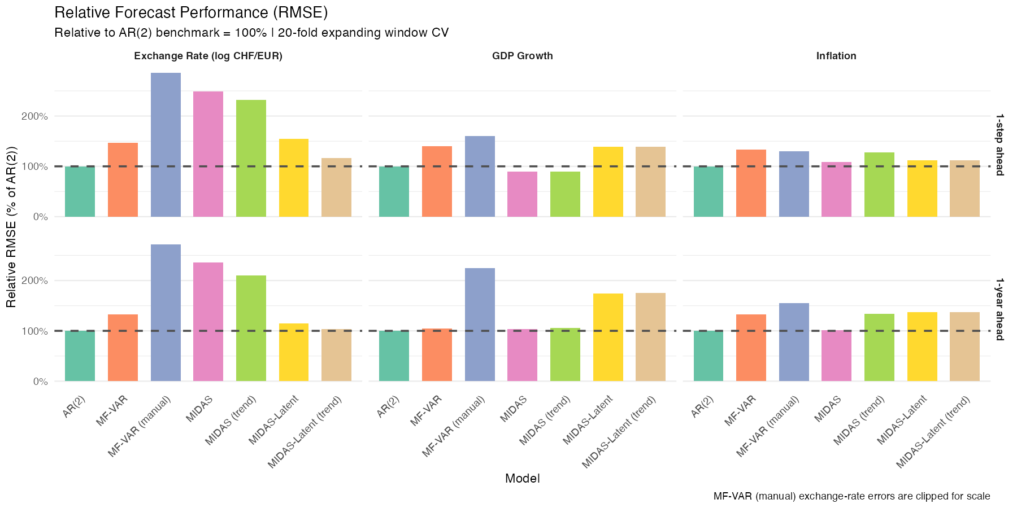

Slide 33
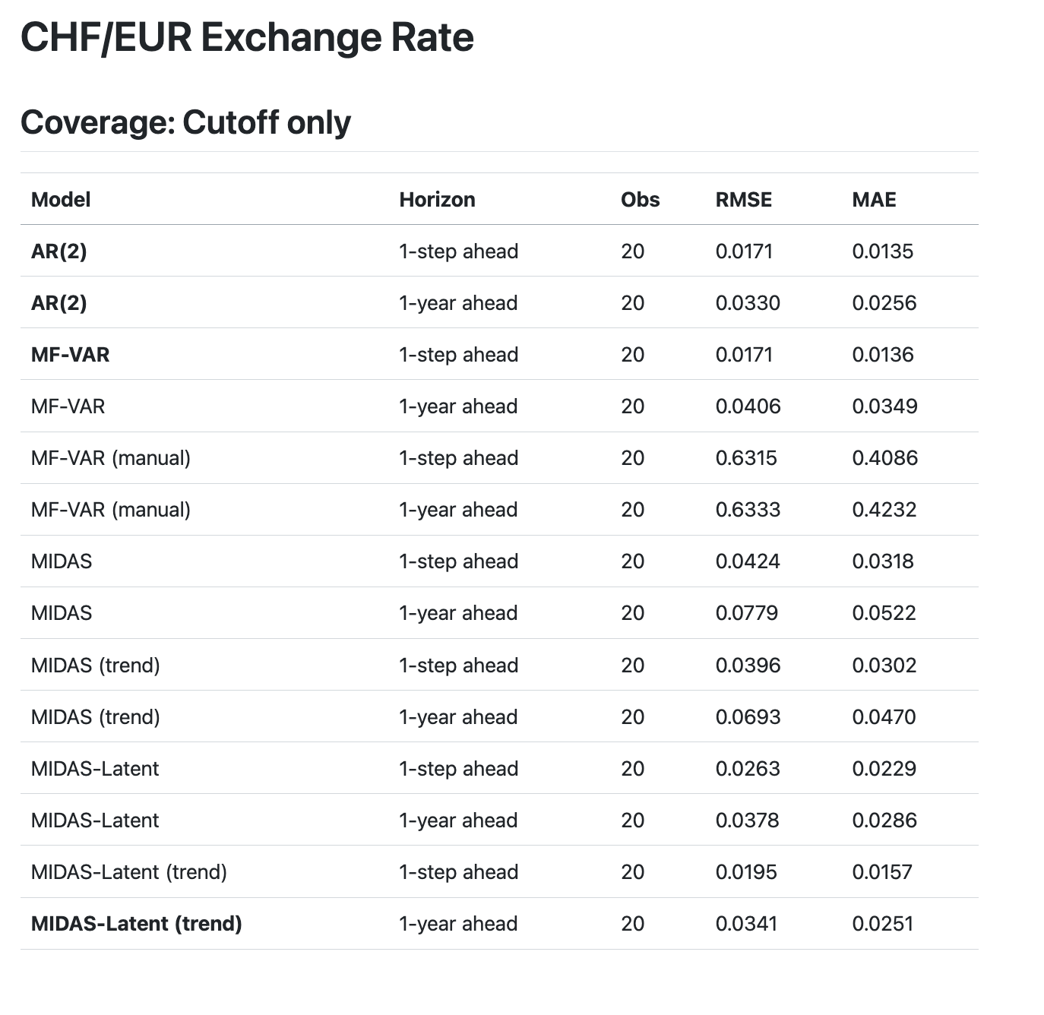
Cross-Validation Summary

Slide 34
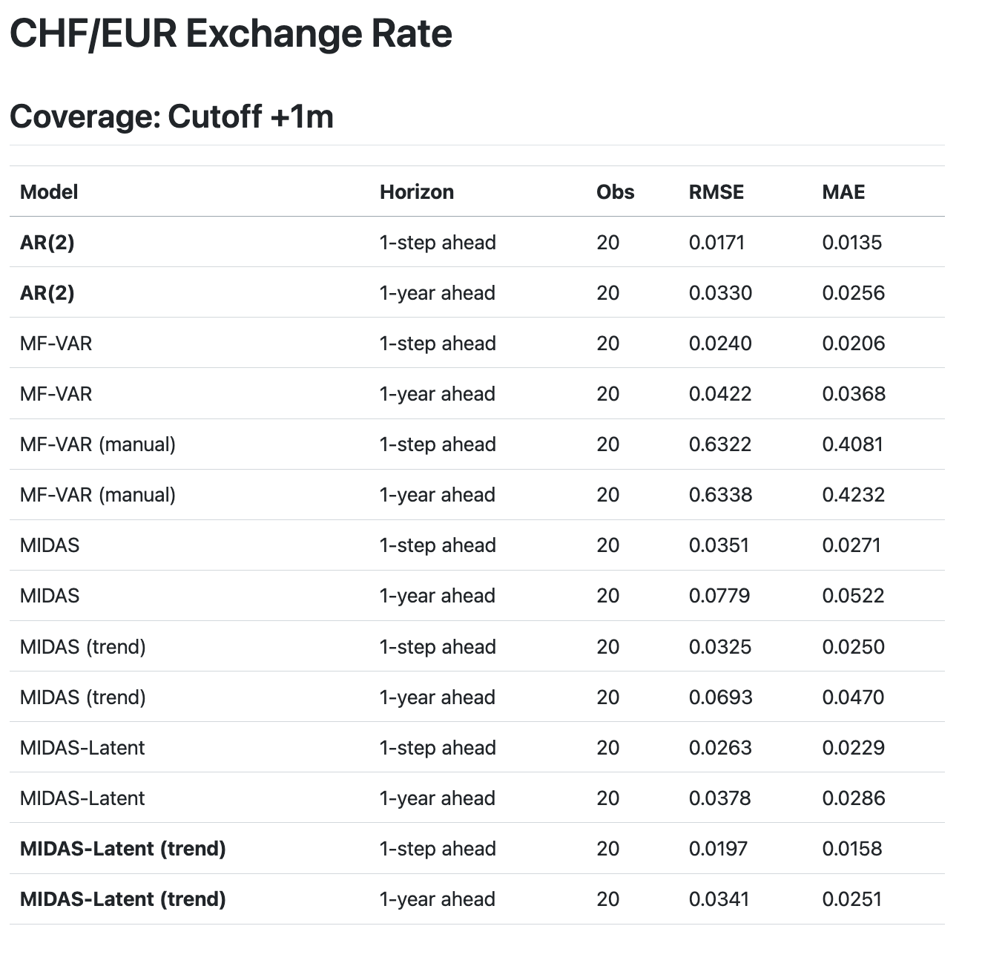
Cross-Validation Summary

Slide 35
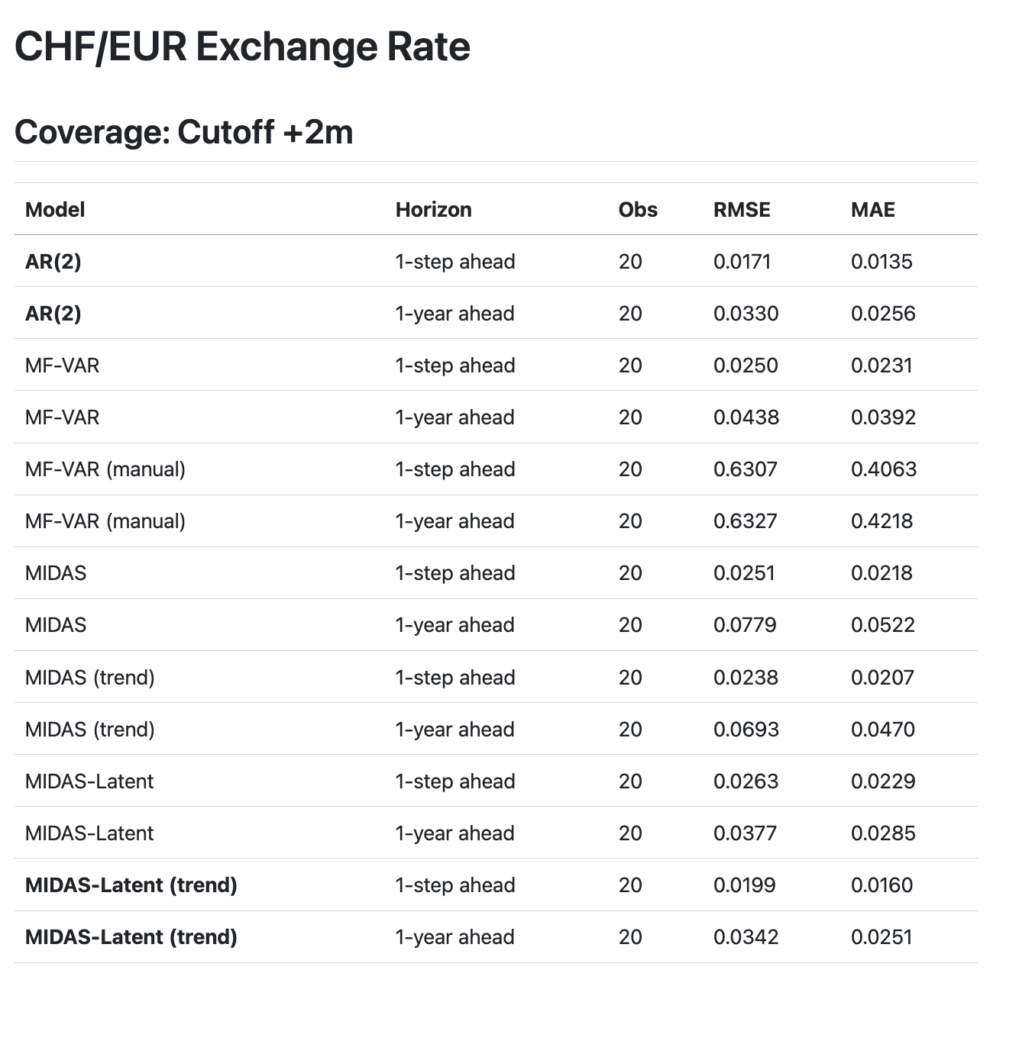
Cross-Validation Summary

Slide 36
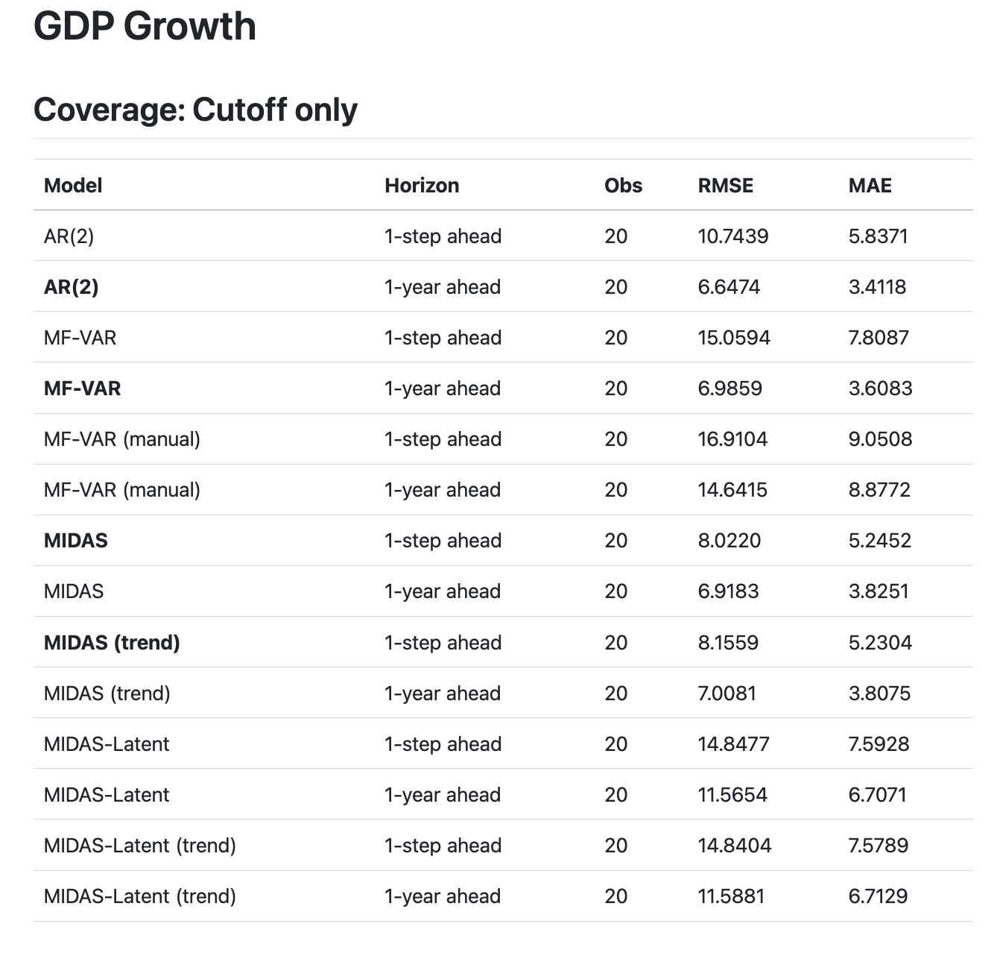
Cross-Validation Summary

Slide 37
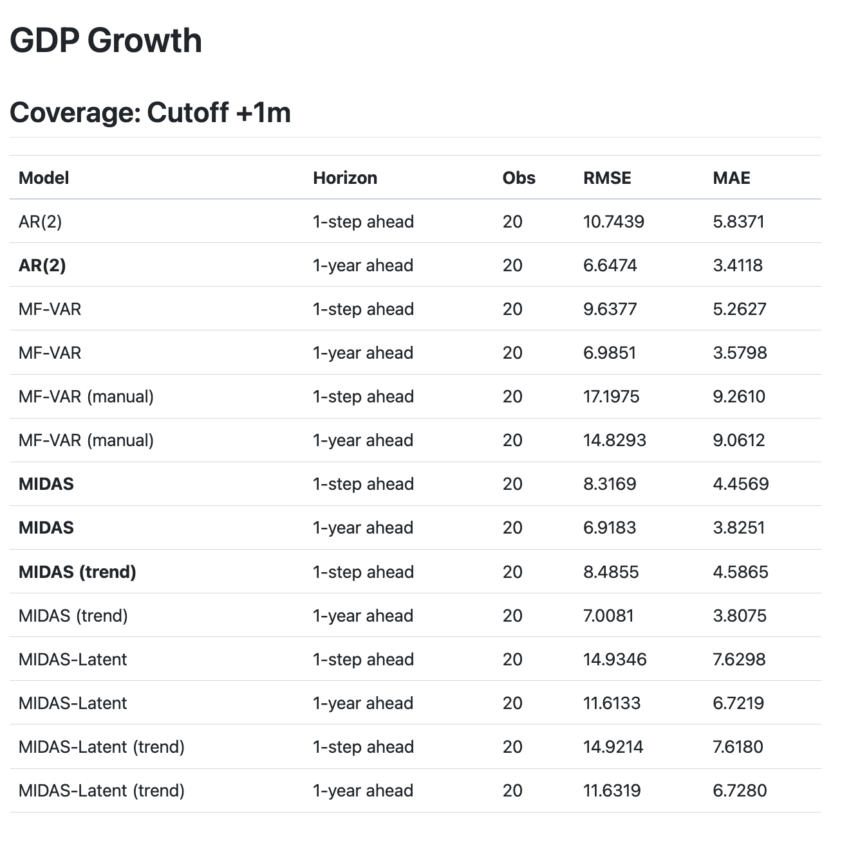
Cross-Validation Summary

Slide 38
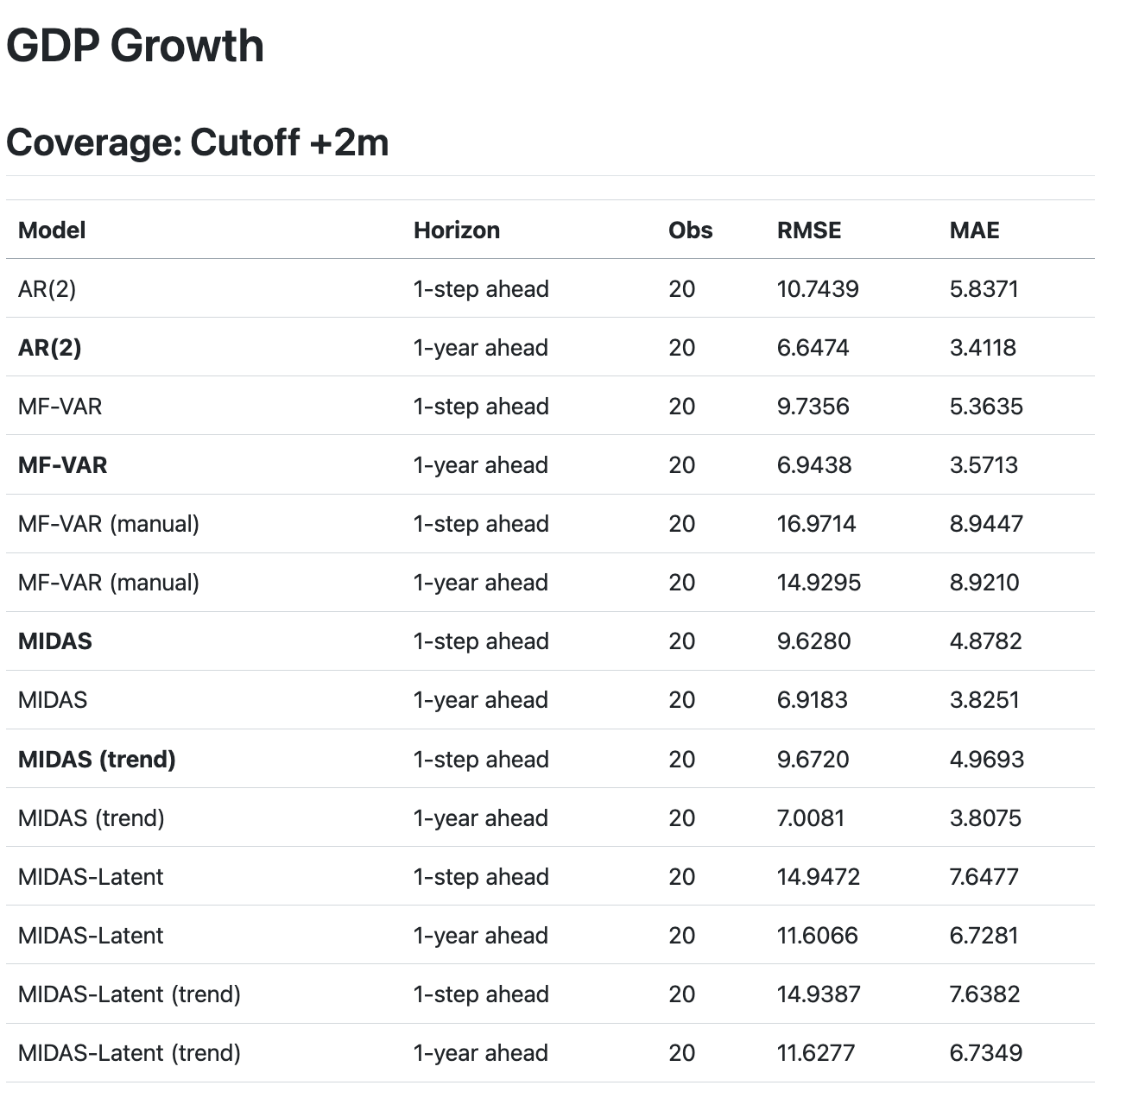
Cross-Validation Summary

Slide 39
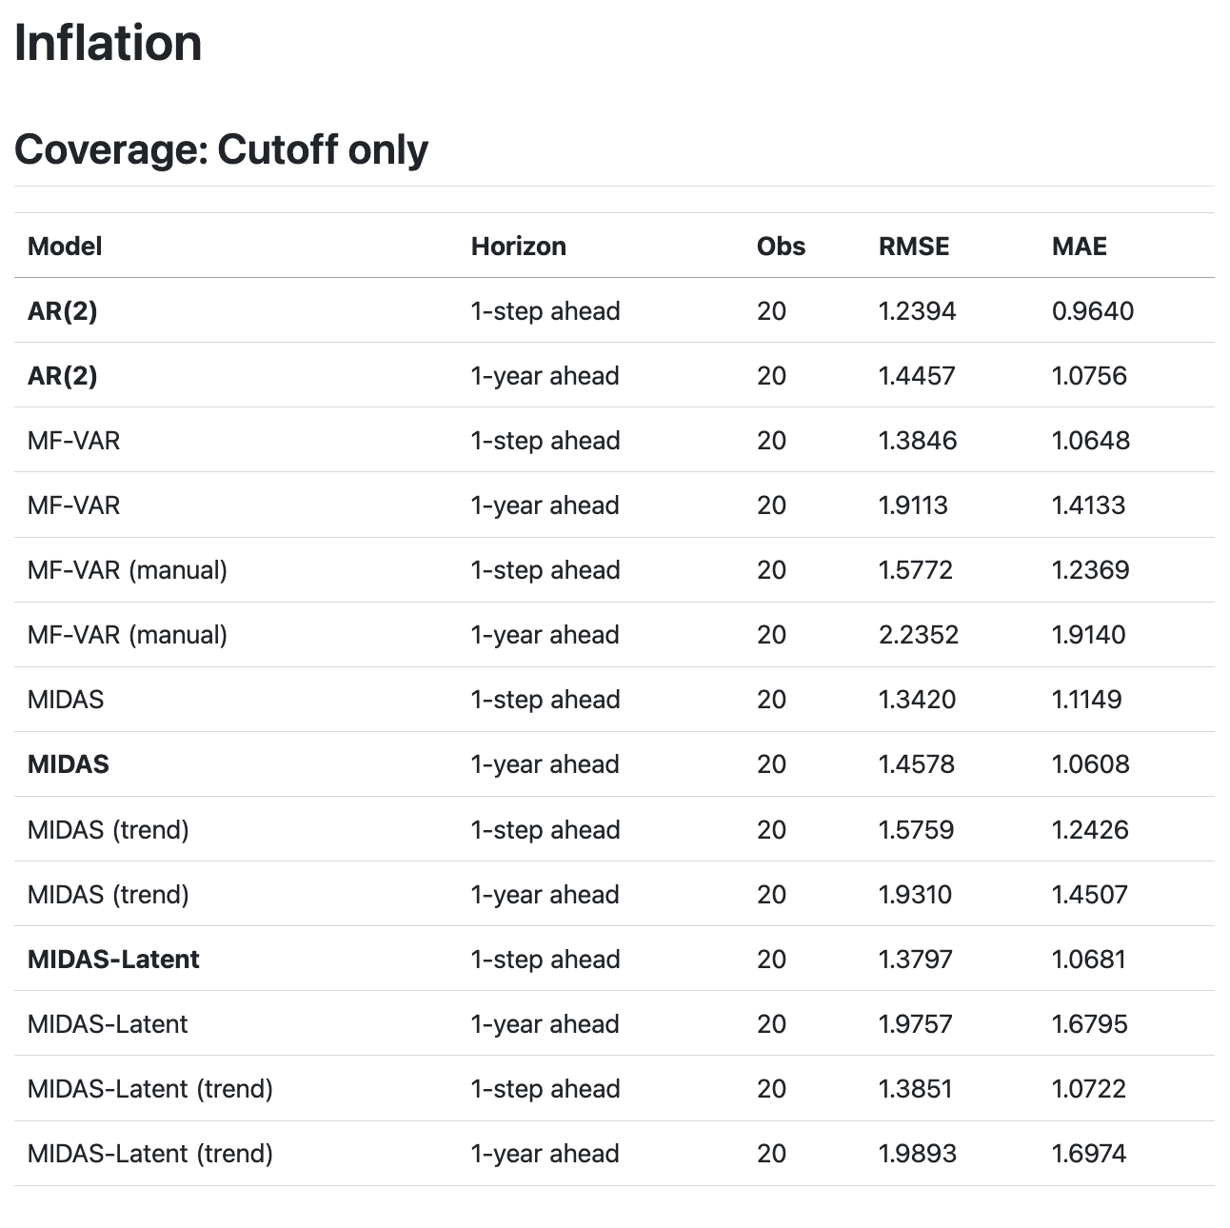
Cross-Validation Summary

Slide 40
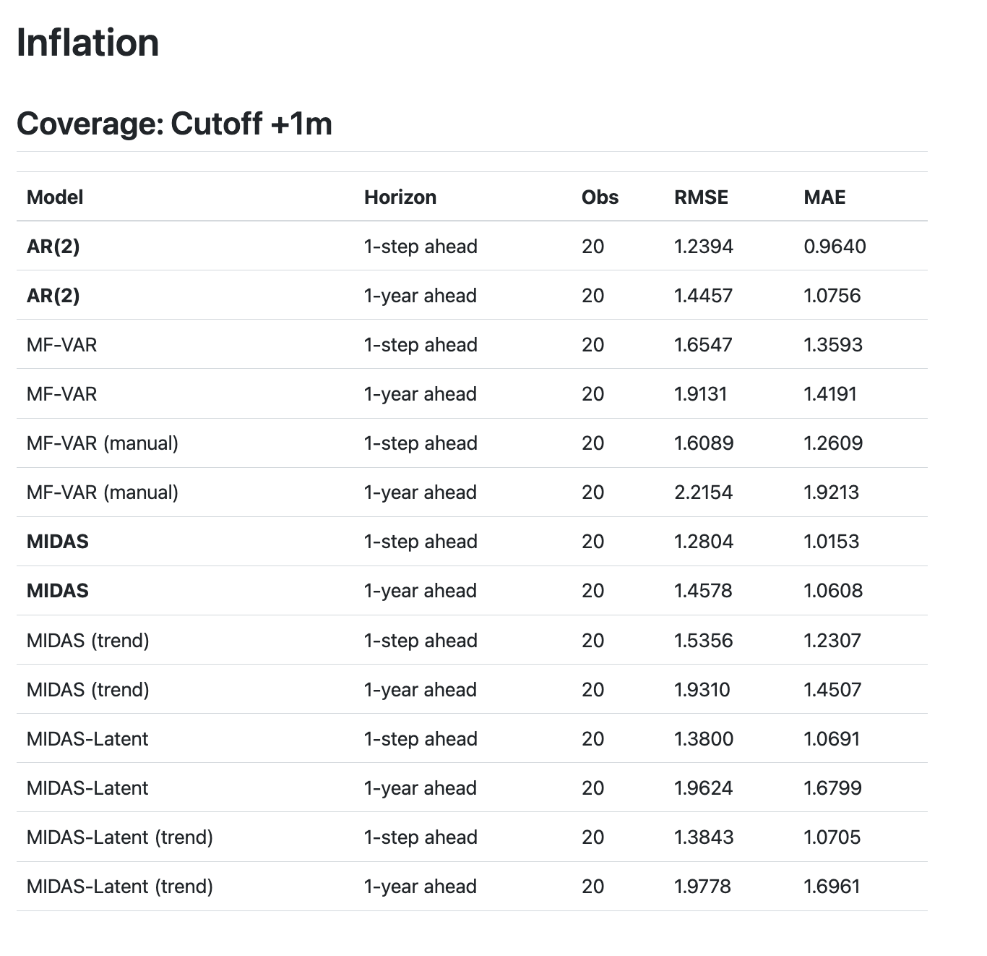
Cross-Validation Summary

Slide 41
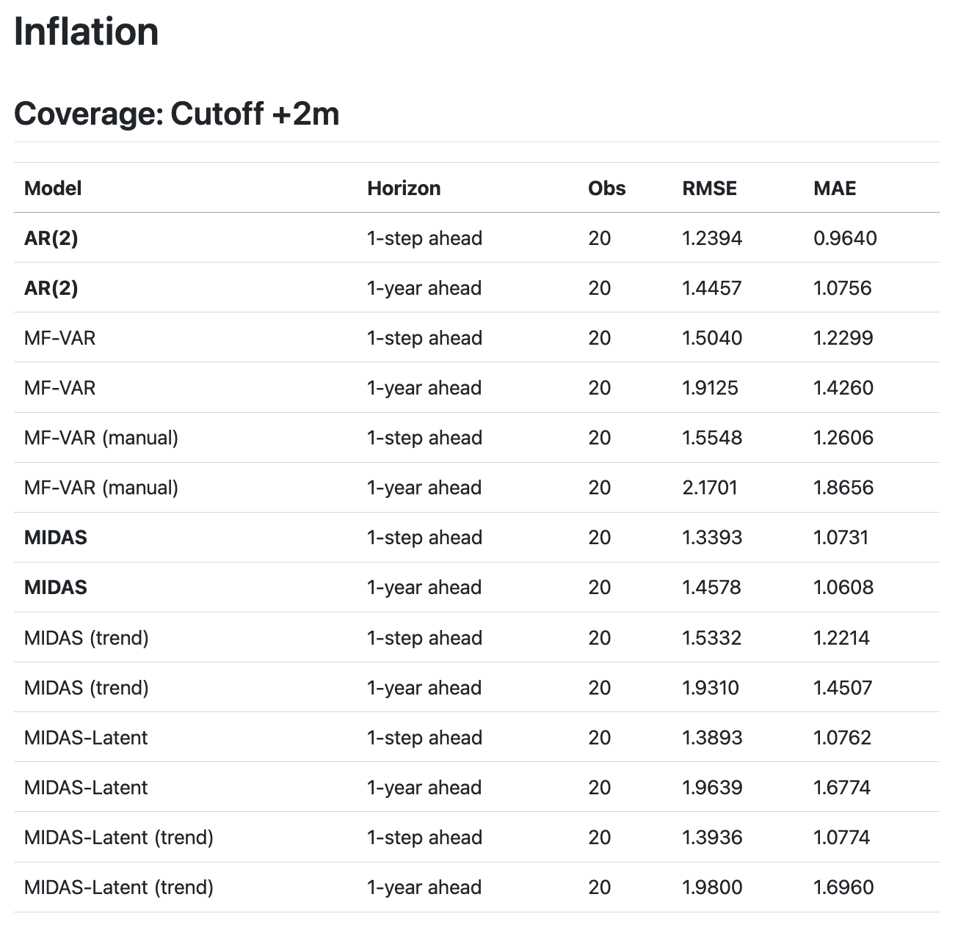
Cross-Validation Summary

Slide 42
Economic Indicators

Slide 43
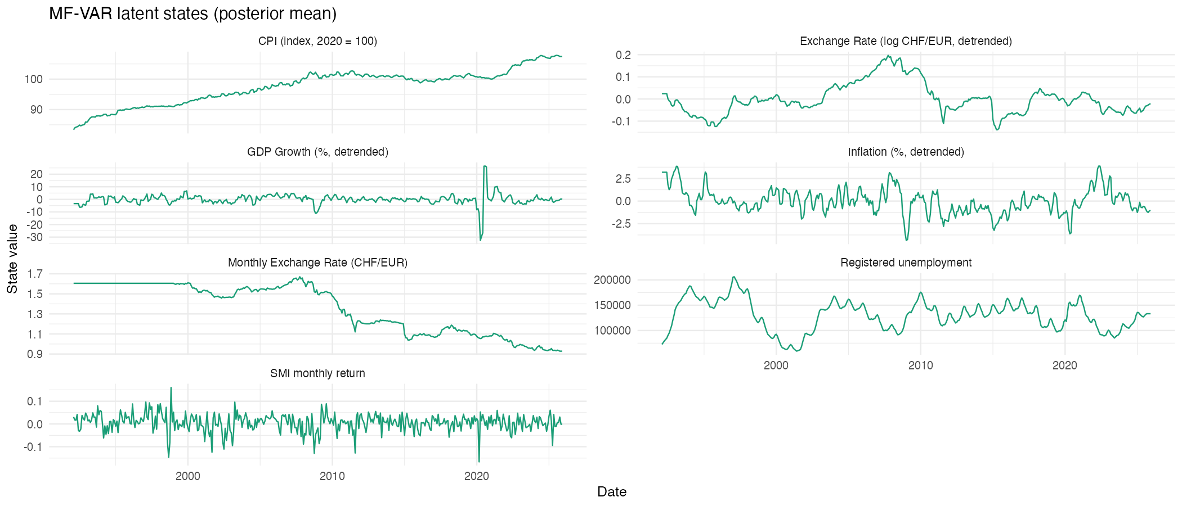

Slide 44
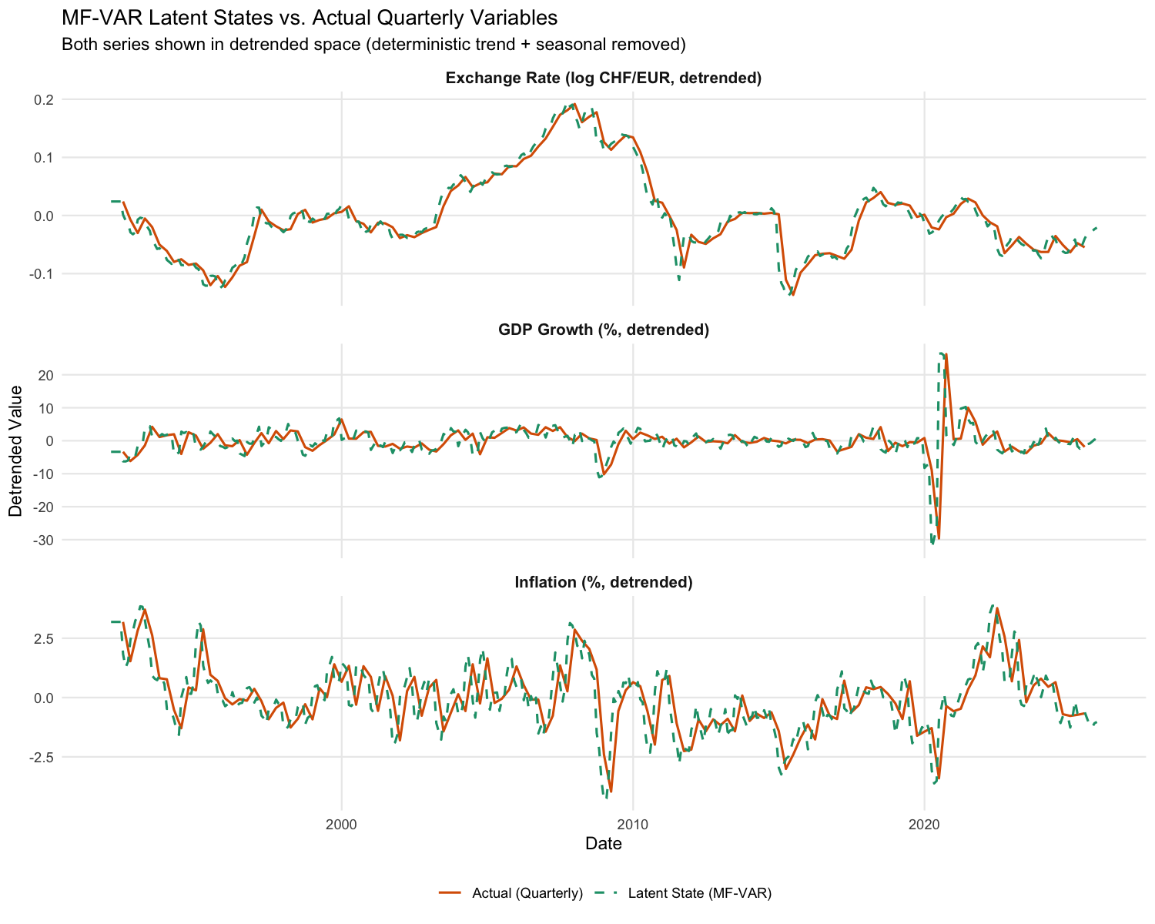

Slide 45
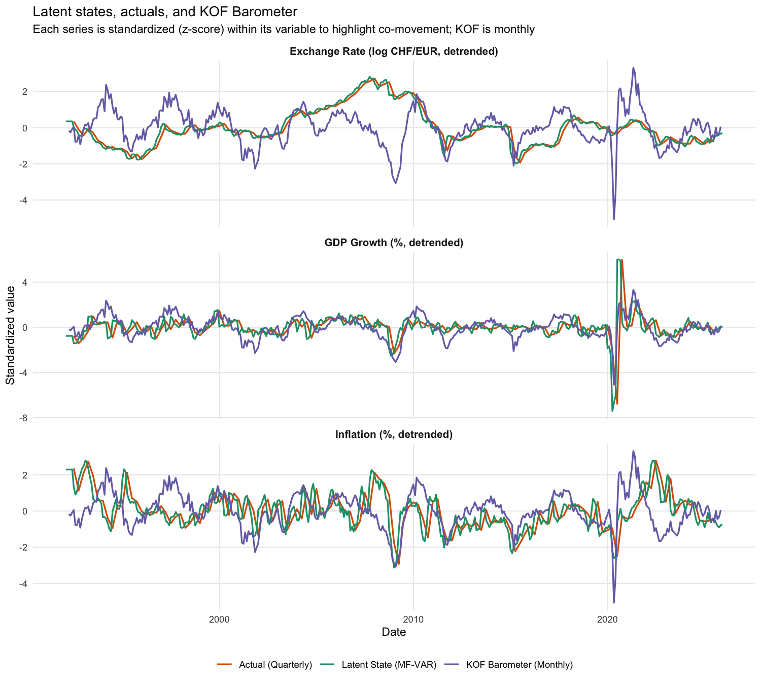

Slide 46
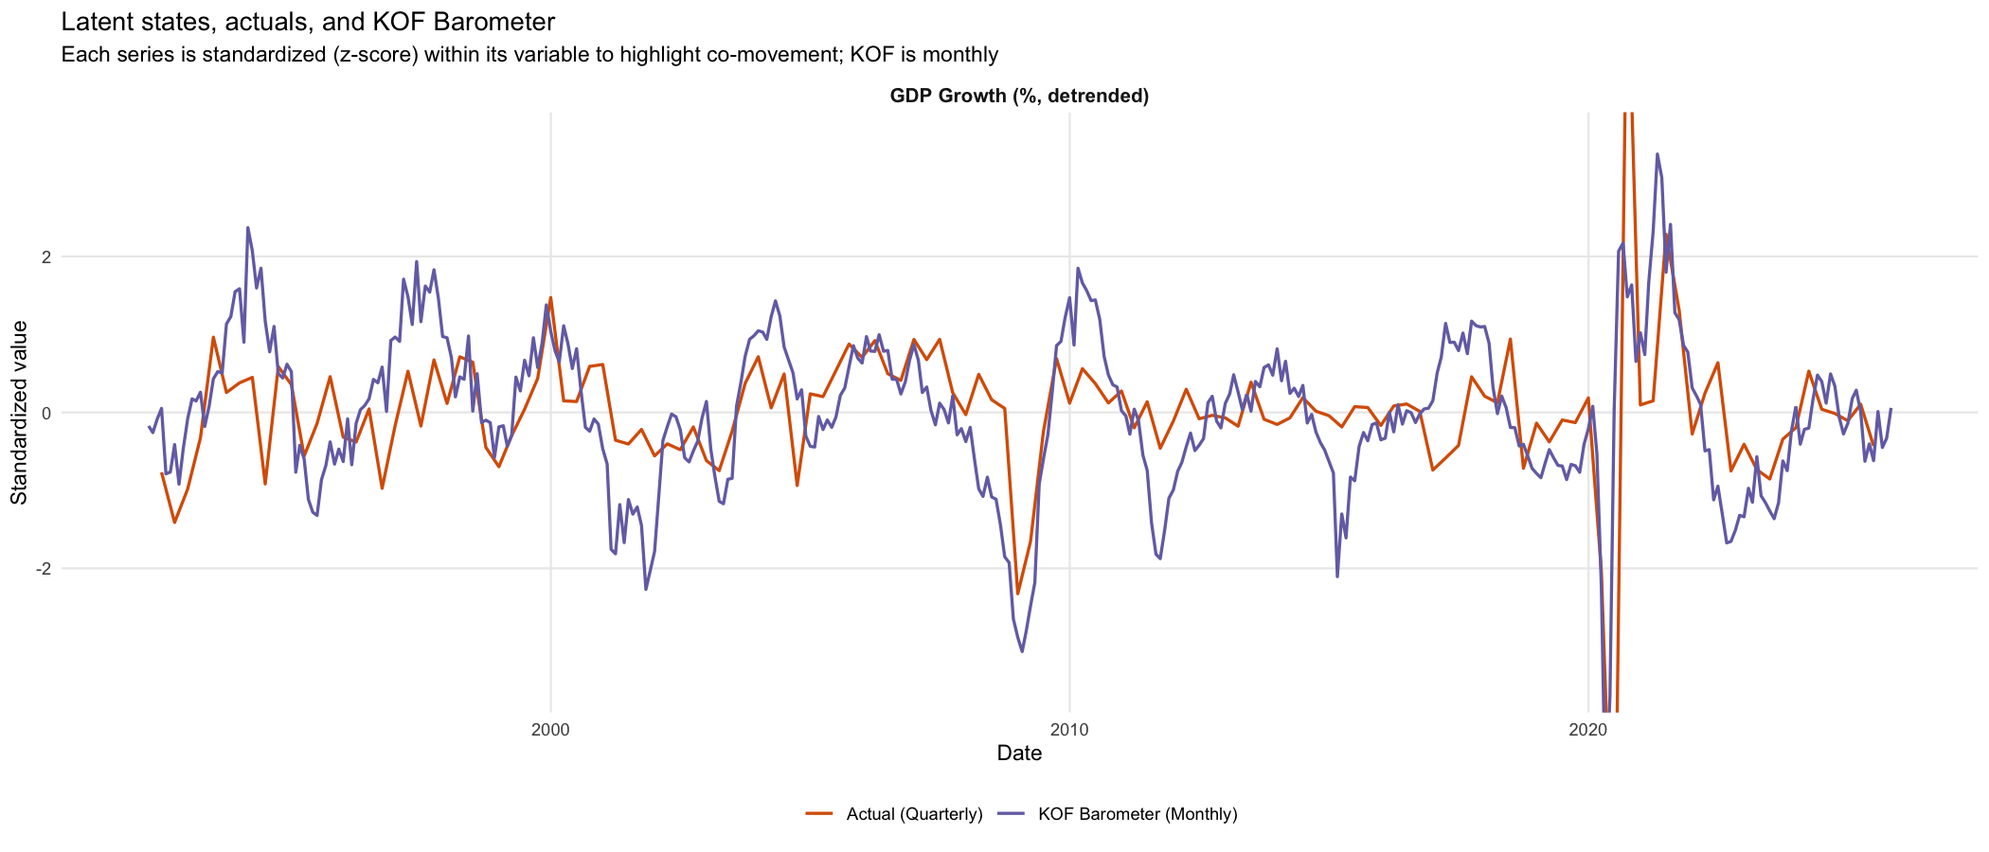
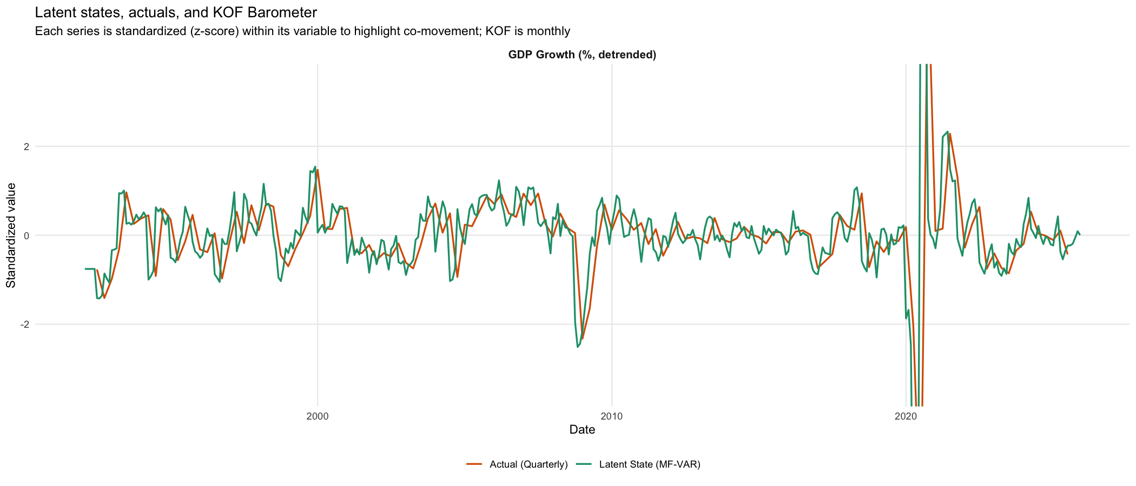
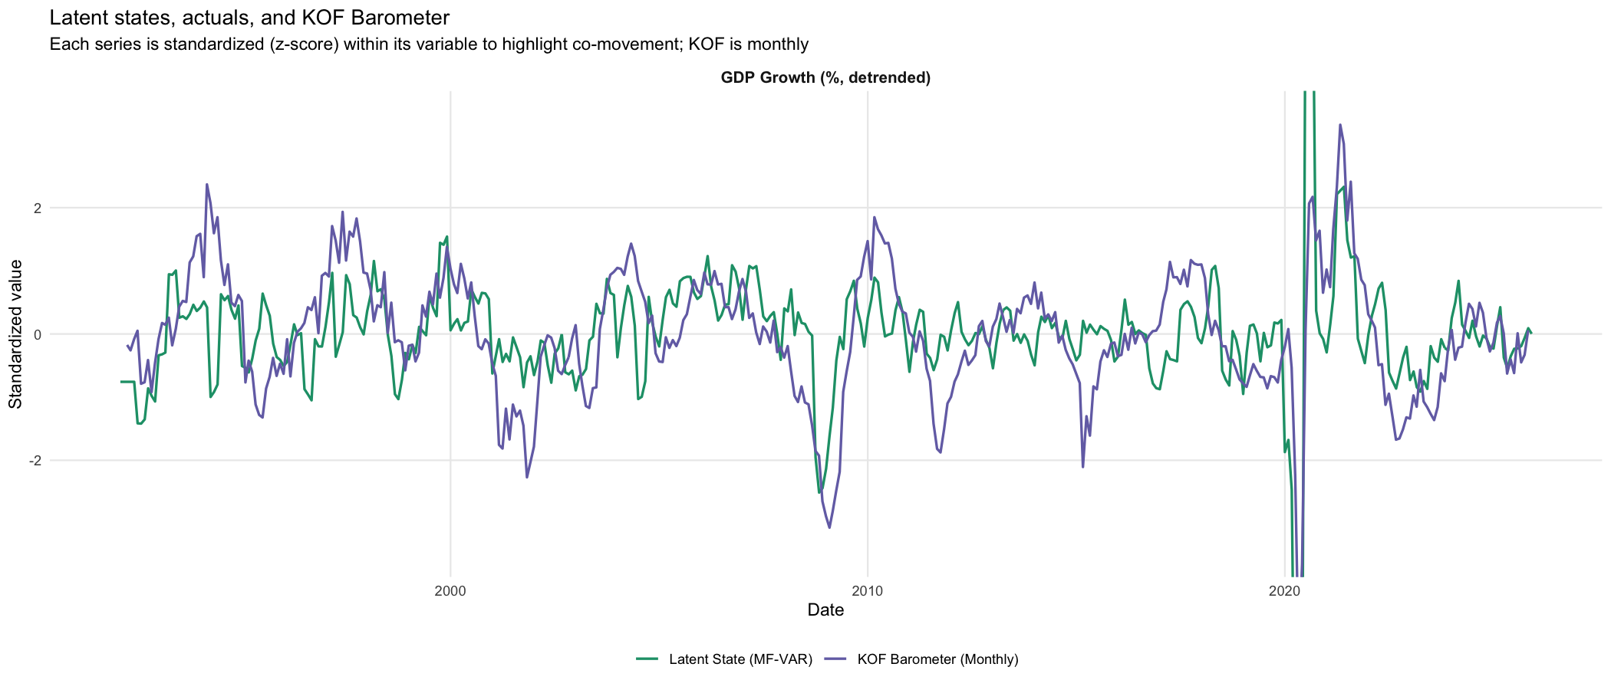

Slide 47
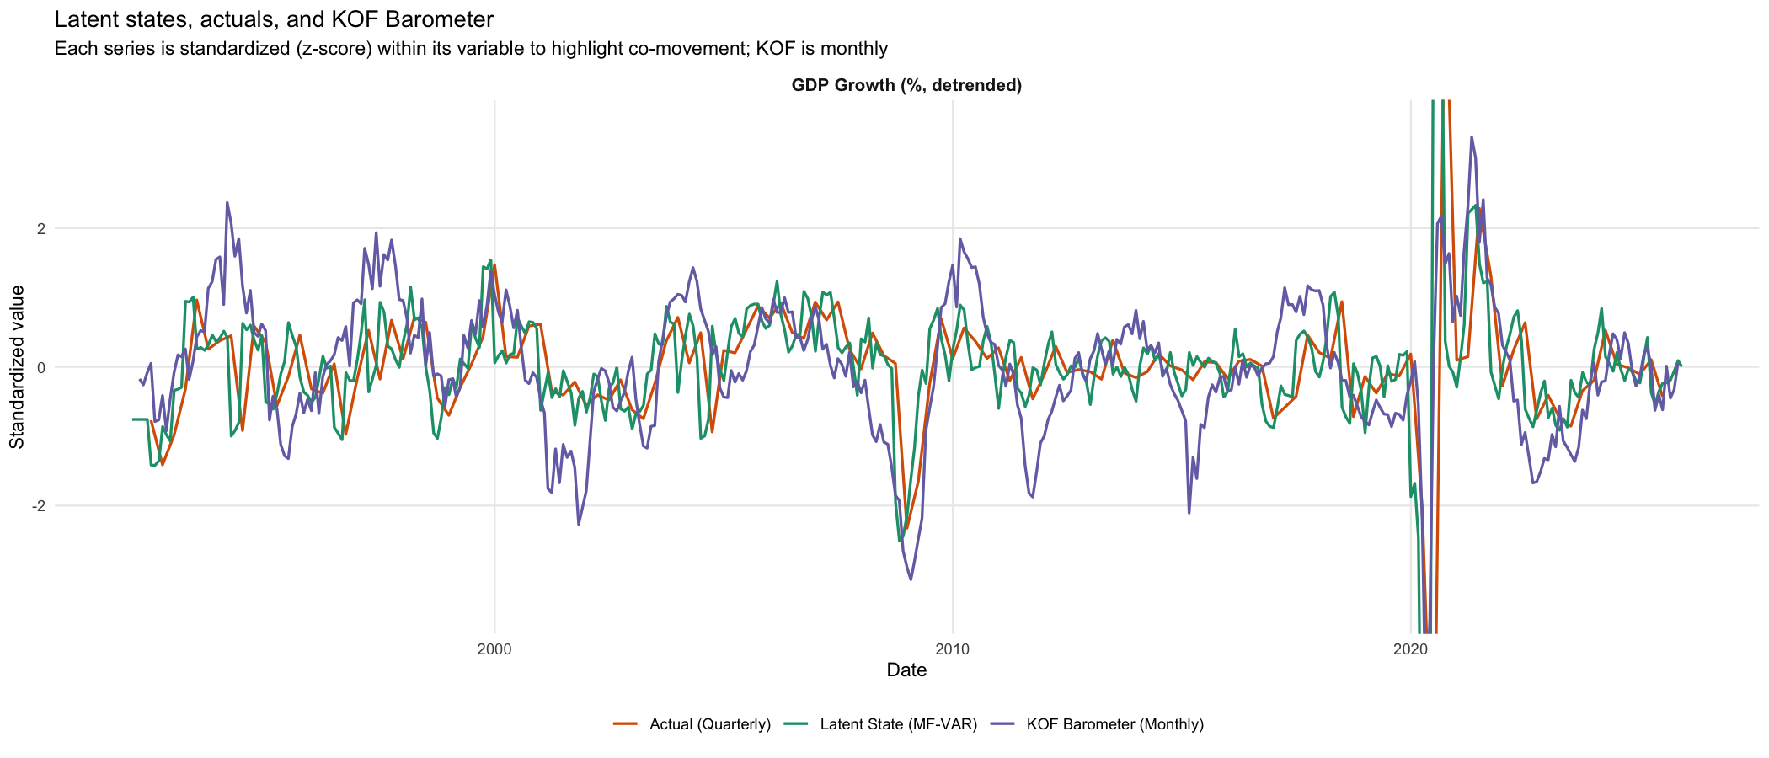

Slide 48
Forecasts
Notes:
Wichtig zum abschluss

Slide 52
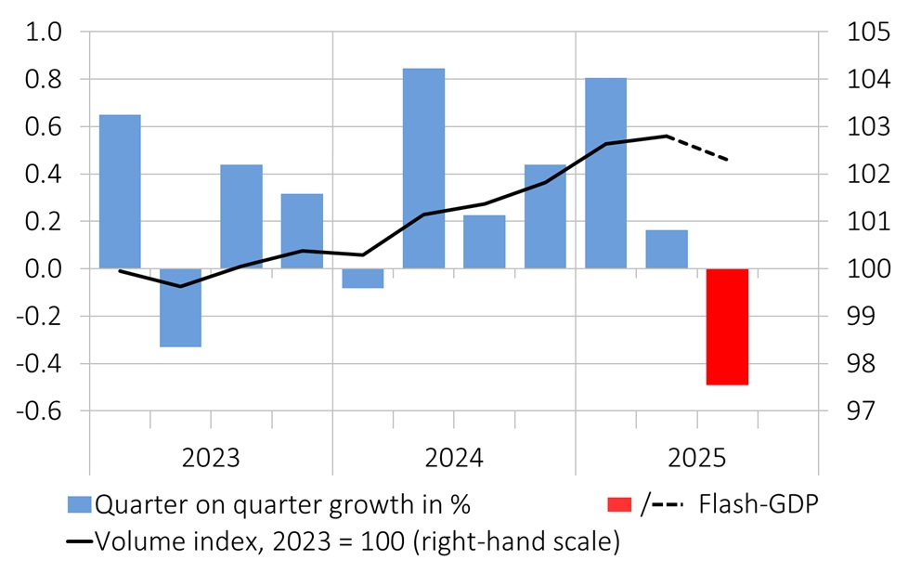
SECO GDP Flash: -0.5%
Source: https://www.seco.admin.ch/seco/en/home/wirtschaftslage---wirtschaftspolitik/Wirtschaftslage/bip-quartalsschaetzungen-/flash-bip.html
Notes:
State Secretariat for Economic Affairs from this Monday.

Slide 53
Interpretation & Takeaways
Notes:
Michal

Slide 54
Results Interpretation
GDP Growth → Mixed Results
Exchange Rate → AR(2) and MIDAS with Latent State
Inflation → AR(2) and MIDAS

Slide 55
Interpretation
Monthly data → latent state monthly index
Indexes track quarterly GDP, inflation, and exchange rate
MF-VAR states act as “shadow” high-frequency series: (smoother) but with same turning points
2025–26 forecasts: GDP dip then recovery, steady-ish inflation, high FX uncertainty

Slide 56
Policy Takeaways
Mixed-frequency methods are useful real-time tools for nowcasting
Simple MIDAS (with MF-VAR states) ≈ or > full MF-VAR in forecast performance
Over-parameterised models can fail badly despite good in-sample fit
Forecast gains are uneven across variables: real activity & prices benefit more than FX
Exchange-rate forecasts remain unreliable → policy should be cautious with FX point forecasts
Model risk is sizeable: results depend on model choice and priors; real-time errors can be large
Best use: as part of a model ensemble, combined with judgement and other tools, not a mechanical rule

Slide 57
Outlook
Improve Latent Space Accuracy (for MIDAS)
Include more relevant time series (snboffzisa, etc.)
Shift publication date more in-front for GDP-growth
Include Vintages for more accurate Forecast Evaluations
Use {rumidas} R package for volatility forecasts

Slide 58
Our GitHub Repository
https://github.com/mddudko/methods-for-macro-forecasting-2025/tree/main/submission
To reproduce, follow the instructions in our README.md file

Slide 59
Thank you for your attention!

Slide 60
Appendix

Slide 61
Appendix

Slide 62
Appendix

Slide 63
Appendix

Slide 64
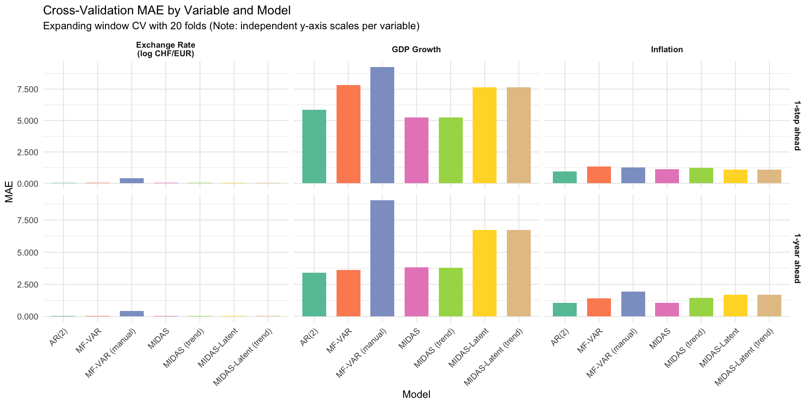

Slide 65
